Slide 1
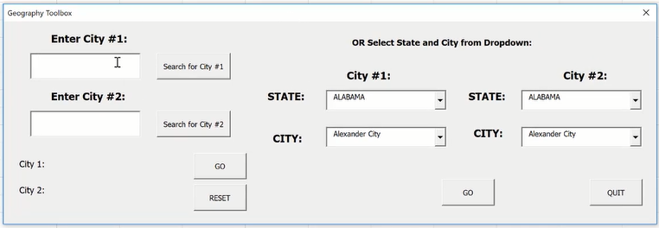
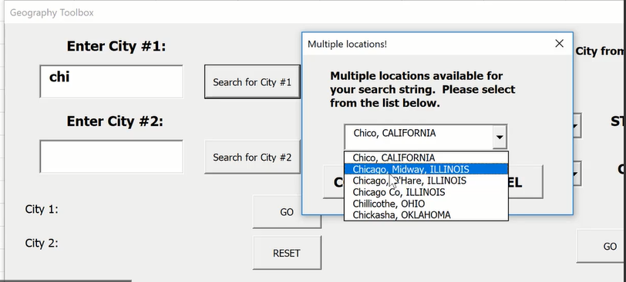
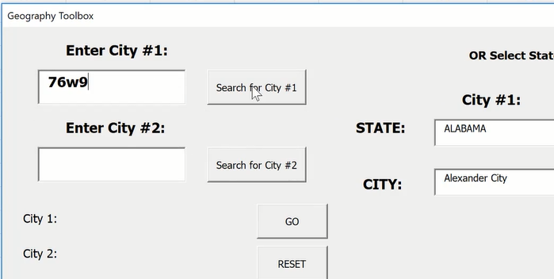
Week 2 – 2 Geography ToolBox
1) When the Convert button is pressed, it will go to the website and find the rate based on the date (default is today’s date) and outputs the converted amount.
2) The last 30 days button finds data based on the date entered and plots the last 30 days value
When you start to type the city name on left. A MsgBox comes up to as you to select from ComboBox
Input validation

Slide 2
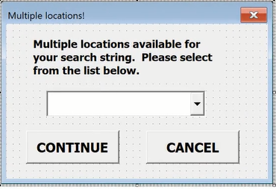
Make two user forms

